Slide 1

HR ANALYTICS EMPLOYEE ATTRITION ANALYSIS

Slide 2

PROJECT OVERVIEW
The HR Analytics Data project focuses on providing a detailed analysis of key human resources metrics within an organization. Utilizing an advanced HR Analytics Dashboard, this project aggregates data on employee count, attrition rates, average age, and job satisfaction. The dashboard highlights critical insights such as the overall attrition rate of 16.12%, department-wise attrition with the highest turnover in Sales (66.29%), and gender-based attrition analysis. Additionally, it offers a breakdown of employee distribution across various age groups, revealing that the majority are between 27-30 years old. Job satisfaction ratings by role and education field-wise attrition data further enhance the understanding of workforce dynamics. By delivering these insights, the HR Analytics Data project aims to help HR managers identify trends, address areas of concern, optimize retention strategies, and improve overall employee satisfaction and organizational efficiency.

Slide 3

TOOLS USED
YouTube - Dataset of HR ANALYTICS was collected from YouTube
Excel - Imported the data in Excel, performed Data Processing, removing Duplicates and Data Cleaning.
SQL Server Management Studio – imported the cleaned HR Analytics Data into SSMS. Written SQL Codes for KPI’s and Charts Requirements
Tableau – Imported the Data in Tableau for data Visualization, Insights, and Interactive Dashboard

Slide 4

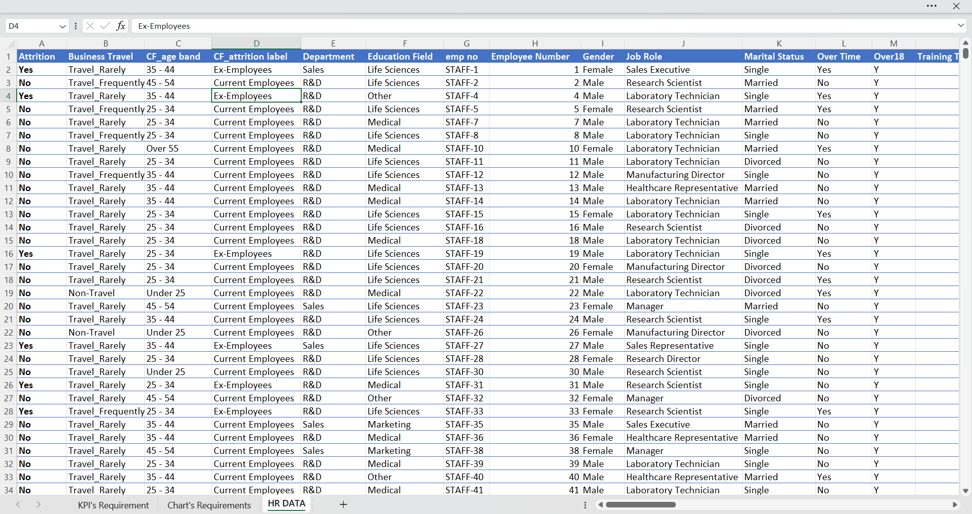
Dataset Overview

Slide 5


SQL CODE
KPI’S REQUIREMENTS
1.Calculate Total Employee Count
SELECT COUNT(employee_count) as employee_count FROM hrdata

Slide 6

2.Calculate Attrition Count
SELECT COUNT(attrition) as attrition_count FROM hrdata
WHERE attrition = 'Yes'

Slide 7

3.Calculate Attrition rate
SELECT CAST(ROUND((CAST(SUM(CASE WHEN (attrition) = 'Yes' THEN 1 ELSE 0 END) AS DECIMAL(10, 2)) *100
/ CAST(COUNT(*) AS DECIMAL(10, 2))), 2) AS DECIMAL(10, 2)) AS Employee_attritionrate
FROM hrdata

Slide 8

4.Calculate Active Employees
SELECT SUM(employee_count) - (select count(attrition) from hrdata where (attrition) = 'Yes')
from hrdata

Slide 9

5.Calculate Average Age
SELECT (ROUND(CAST(AVG(Coalesce(age, 0.0)) AS DECIMAL(10, 0)), 0)) AS Avg_Age from hrdata

Slide 10

CHART’S REQUIREMENTS
1.Calculate Attrition By Gender
SELECT COUNT(attrition) AS Attrition_By_Gender, gender FROM hrdata
WHERE (attrition) = 'Yes'
GROUP BY gender
ORDER BY COUNT(attrition) DESC

Slide 11
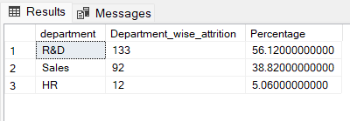
2.Calculate Department Wise Attrition
SELECT department, COUNT(attrition) AS Department_wise_attrition, ROUND((CAST(COUNT(attrition) AS NUMERIC) /
(SELECT COUNT(attrition) FROM hrdata WHERE attrition = 'Yes'))*100, 2) AS Percentage
FROM hrdata
WHERE (attrition) = 'Yes'
GROUP BY department
ORDER BY COUNT(attrition) DESC

Slide 12
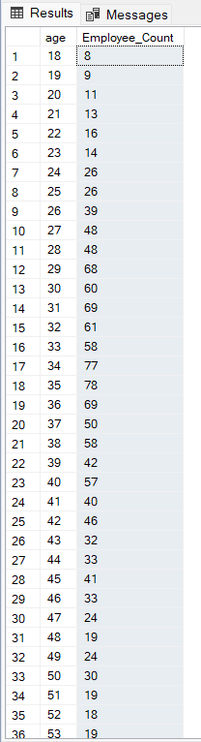
3.Calculate No.of Employee by Age Group
SELECT age, SUM(employee_count) AS Employee_Count FROM hrdata
GROUP BY age
ORDER BY age

Slide 13
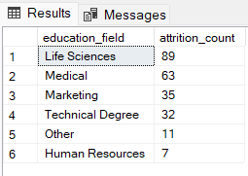
4.Calculate Education Field Wise Attrition
SELECT education_field, COUNT(attrition) AS attrition_count FROM hrdata
WHERE (attrition) = 'Yes'
GROUP BY education_field
ORDER BY COUNT(attrition) DESC

Slide 14
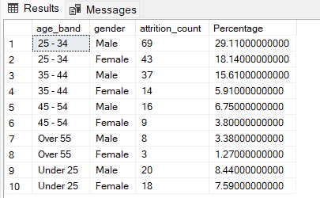
5.Calculate Attrition Rate by Gender for Different AgeGroup
SELECT age_band, gender, COUNT(attrition) as attrition_count,
ROUND((CAST(COUNT(attrition) AS NUMERIC) /
(SELECT COUNT(attrition) FROM hrdata WHERE attrition = 'Yes'))*100, 2) AS Percentage
FROM hrdata
WHERE attrition = 'Yes'
GROUP BY age_band, gender
ORDER BY age_band, gender DESC

Slide 15

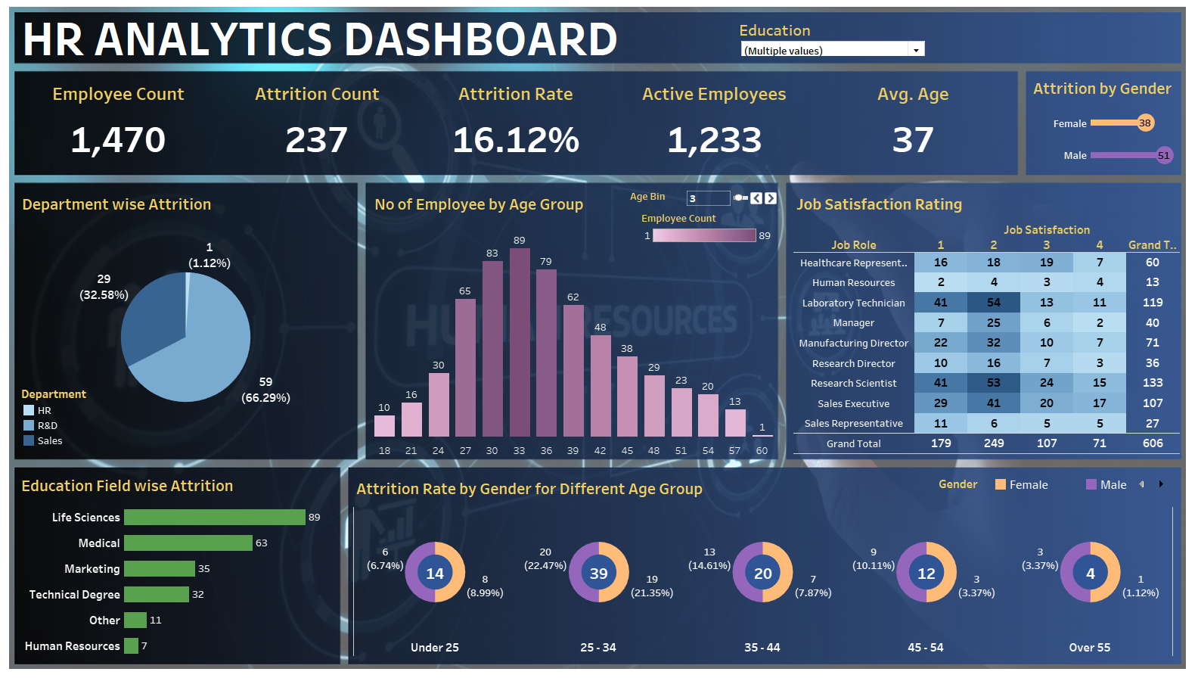
TABLEAU DASHBOARD

Slide 16

STORY TELLING
This HR Analytics Dashboard consolidates key workforce metrics, providing a comprehensive view of employee demographics, attrition, and satisfaction across departments and age groups. By visualizing critical data points, it empowers HR to make informed decisions on talent management, retention strategies, and employee engagement initiatives, ultimately fostering a more effective and satisfied workforce.

